Slide 1

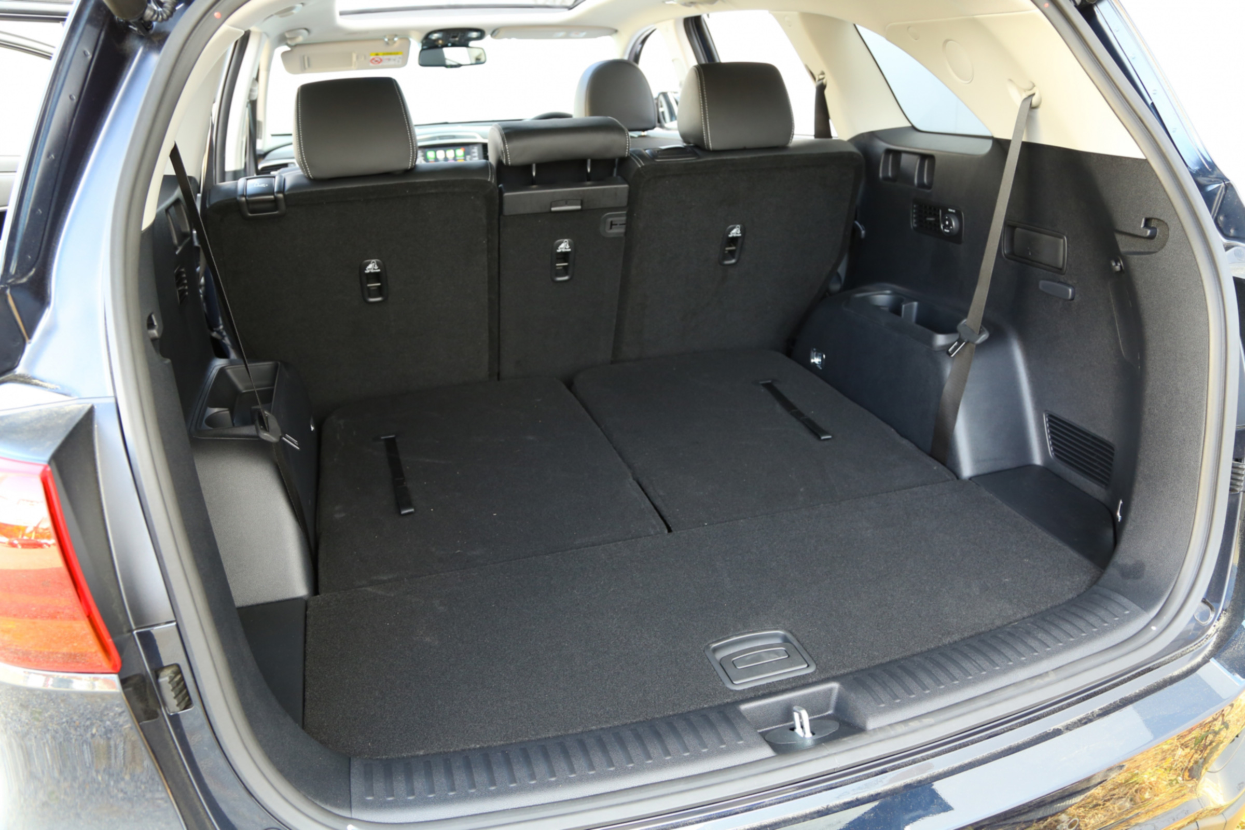
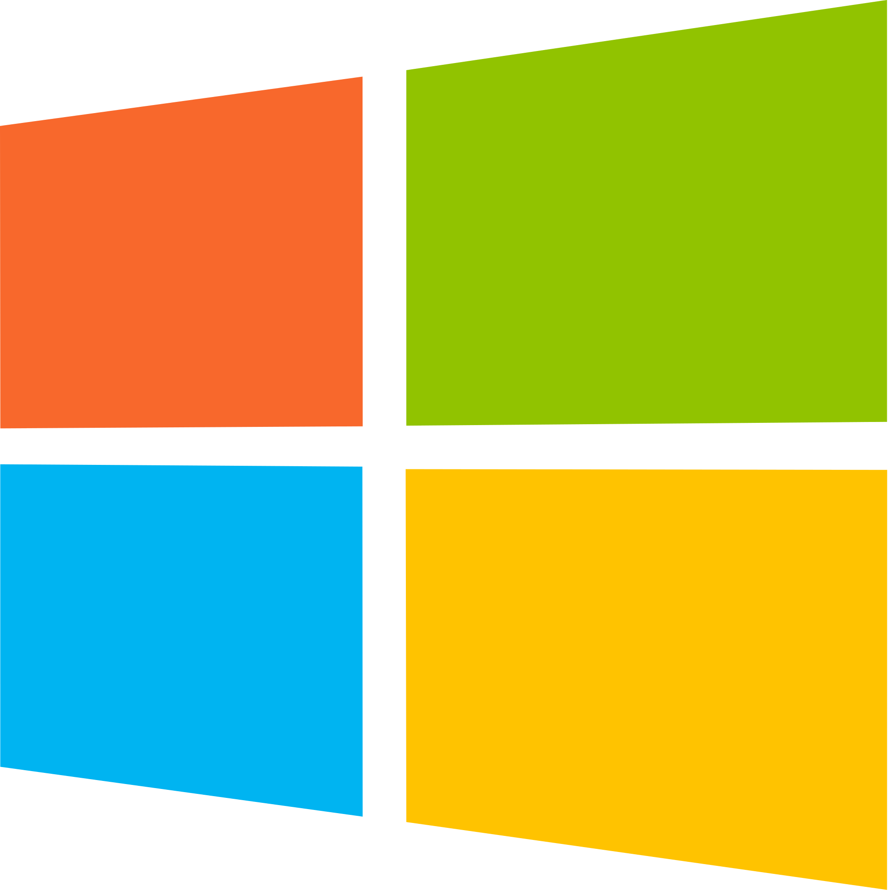

Dual Booting
// cianky
// ciantkehoe@gmail.com
// github.com/ciankehoe
// mag1c
// mag1c@redbrick.dcu.ie

Slide 2
What is Dual booting?
“A dual boot system is a computer system in which two operating systems are installed on the same hard drive*, allowing either operating system to be loaded and given control.”
Splitting your hard drive into multiple independent sections → partitioning.
Manage each of these sections separately.
* You can use different / multiple drives!
Notes:
Mention school of computing boot screens
(safety net of putting personal files on one partition and main OS on another. Protecting your files in case of OS corruption)

Slide 3
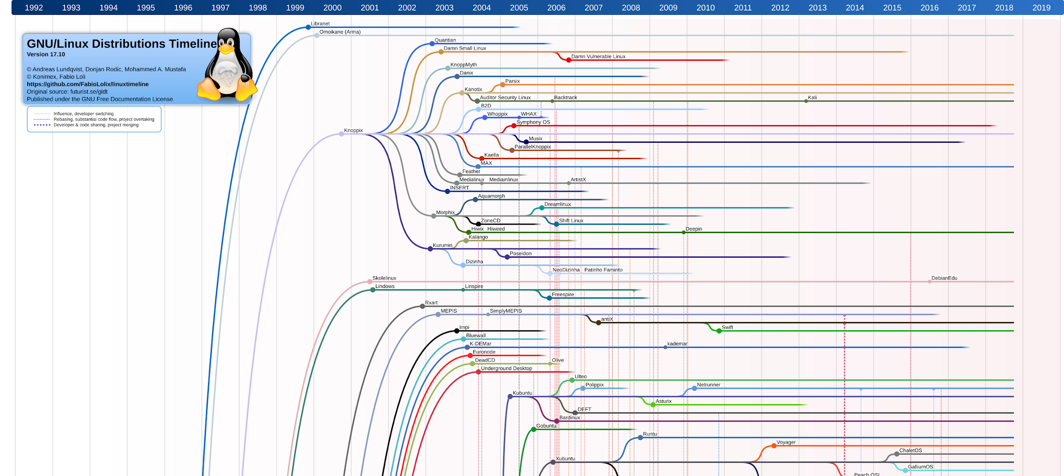
So many options

Slide 4

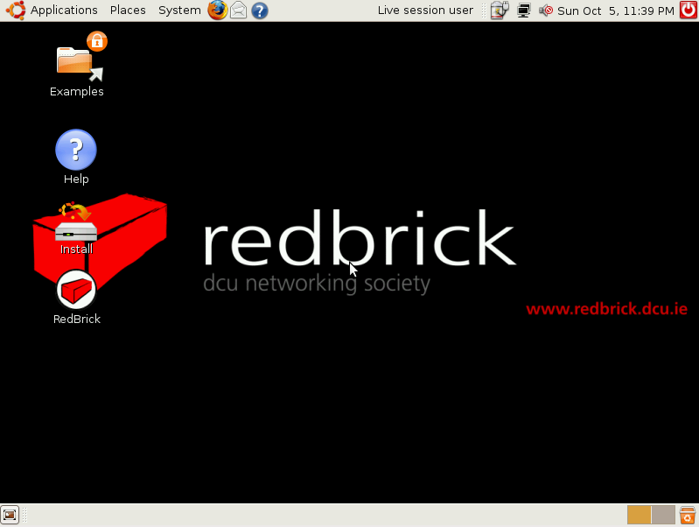

Redbrick even has one!

Slide 5
Why should I Dual Boot?
Best of both worlds
Platform specific applications / compatibility
Access to resources (Versus VM)
Learning and experimentation
Linux can be a better development environment
Gaming!
It’s pretty easy
Notes:
Linux knowledge looks great on a CV

Slide 6
Partitions & Partition Tables
Partitions and partition tables
A partition is a fixed-size subset of a disk drive.
Splitting one physical HDD / SSD into multiple logical disks/volumes
OS will treat these as completely separate physical drives
Partitions can be created, resized, or deleted.
Notes:
Windows comes with recovery partition

Slide 7
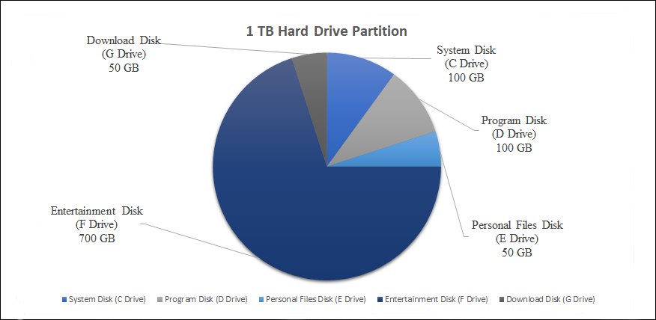
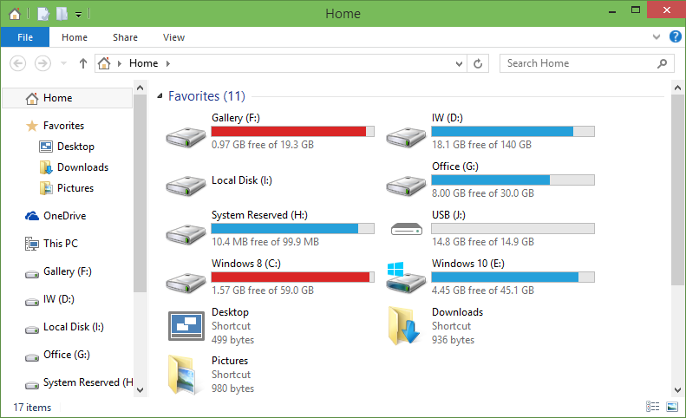

Slide 8
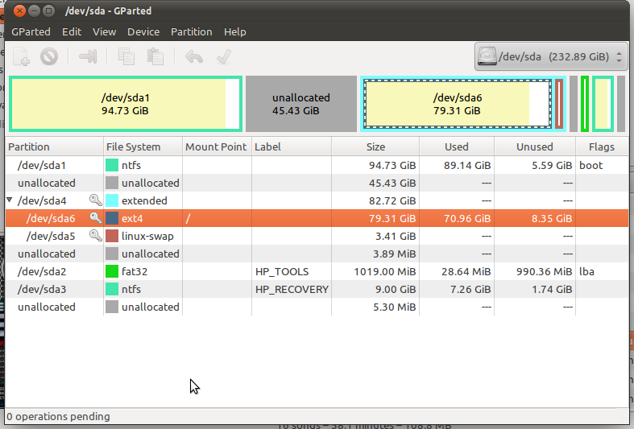
Partition Table
A partition table is a table maintained on disk by the operating system describing the partitions on that disk.
Partition table is read first on boot.

Slide 9
The Process
Make a backup (recommended)
Create a bootable USB
Disable Fast Startup [Optional]
Change to UEFI through BIOS [May be done]
Disable Secure Boot
Begin the installation
We will do this through Ubuntu. Can be done through Windows Disk Management
Manual / Auto (Guided) Partition
Fill in details.
Reboot and you’re done!

Slide 10
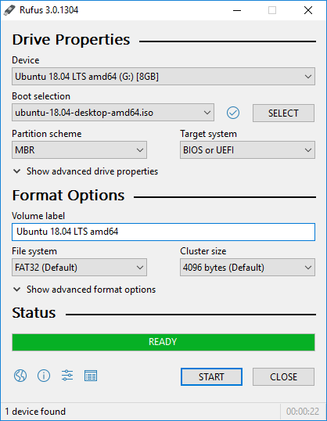
Create Bootable USB
Bootable USB
Download and Install Rufus → https://rufus.ie/
Download Ubuntu Desktop ISO → https://ubuntu.com/download/desktop
Create the bootable drive with Rufus!

Slide 11
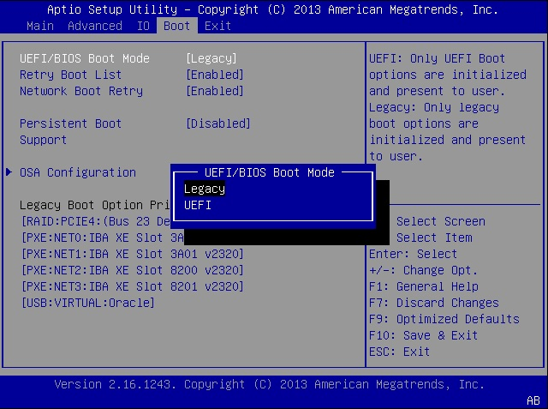
Enable UEFI Boot
Bootable USB

Slide 12
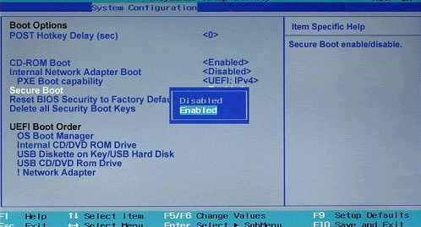
Disable Secure Boot
Bootable USB
What is secure boot?
Makes sure the machine only boots into safe / verified software.
It’s there to prevent rootkit viruses from running.
It treats Linux as a virus!

Slide 13
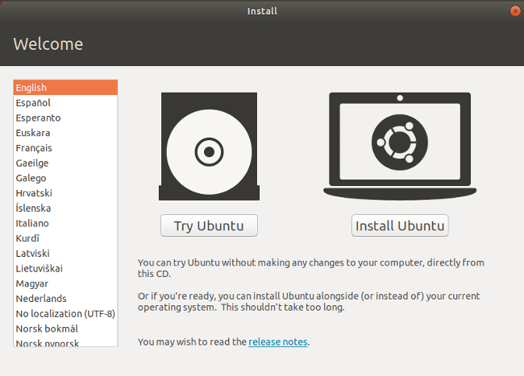
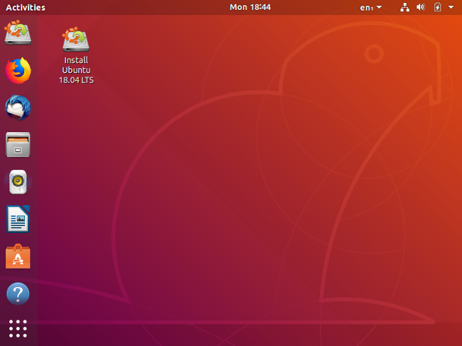
Installation!
Bootable USB
You can try it out before installing!
Use as a portable bootable USB

Slide 14
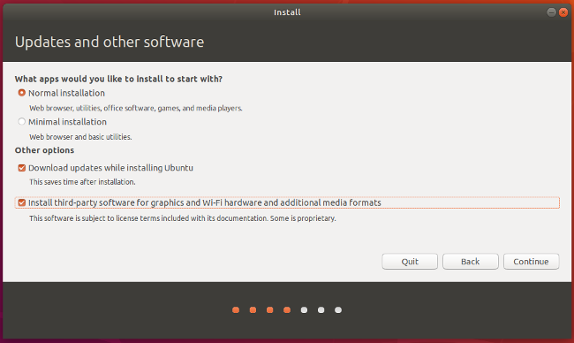
Installation!
Bootable USB

Slide 15
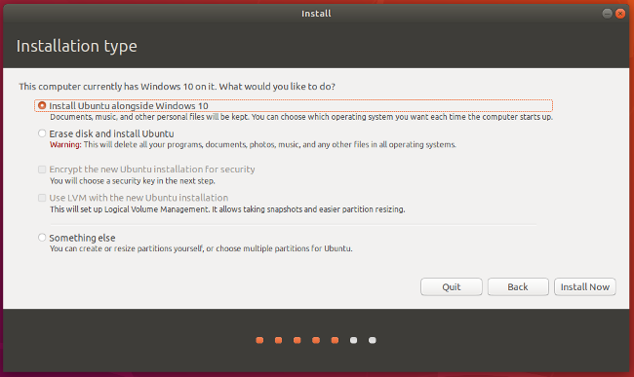
Installation - Where?
Bootable USB

Slide 16
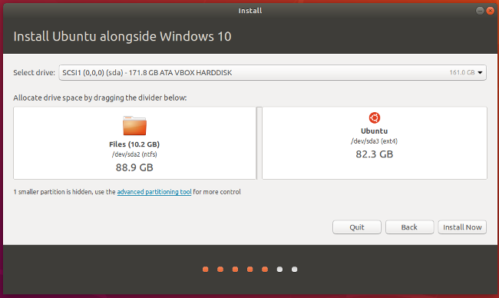
Where & Size
Bootable USB

Slide 17
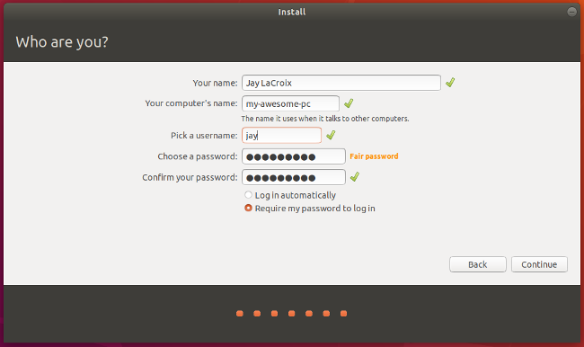
Fill in your info
Bootable USB

Slide 18
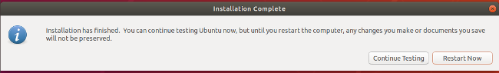
Finish and Reboot
Bootable USB

Slide 19
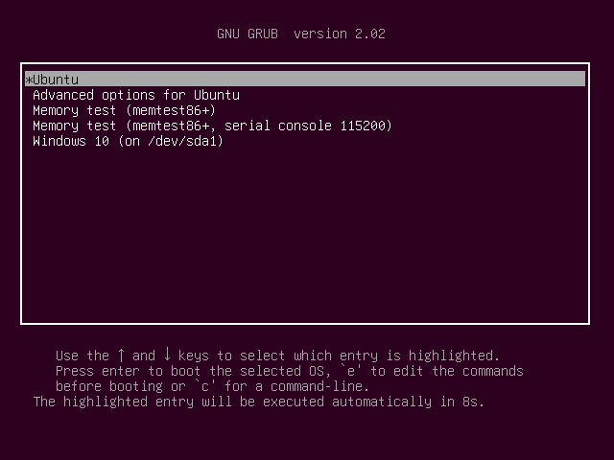
You’re all done!
Bootable USB

Slide 20
Thanks for coming!
Now let’s get started.

